Slide 1
PSHE
Updated Curriculum Sept 23

Slide 2
PHSE

Slide 5
SRE Education (Primary):
The Relationships Education, SRE, and Health Education (England) Regulations 2019 have made Relationships Education compulsory in all primary schools – not sex education. The content of the guidance focuses on Relationships Education.
Teach about relationships and health – including puberty.
National Curriculum Science – main external body parts, the human body as it grows from birth to old age. Life cycle of plants and animals.
Programme tailored to the age and physical and emotional maturity of the pupils, but it should prepare the children for the changes that take place (drawing on the knowledge of the human life cycle from the National Curriculum for Science).

Slide 6
Relationships Education
At a primary school level, relationships education teaches children a wealth of information about healthy relationships, including how to communicate their own boundaries and recognise the boundaries of others, staying safe online, and the differences between appropriate and inappropriate or unsafe contact.
Our programme is tailored to the age and physical and emotional maturity of the pupils, and it prepares our older children for the changes that take place (drawing on the knowledge of the human life cycle from the National Curriculum for Science).
We recognise the need to balance statutory guidelines and parental views when teaching SRE. We have amended the curriculum to ensure key vocabulary and concepts are taught in a sensitive, appropriate manner.

Slide 10
Summer Term topics adjusted changing me .. See website planning

Slide 14
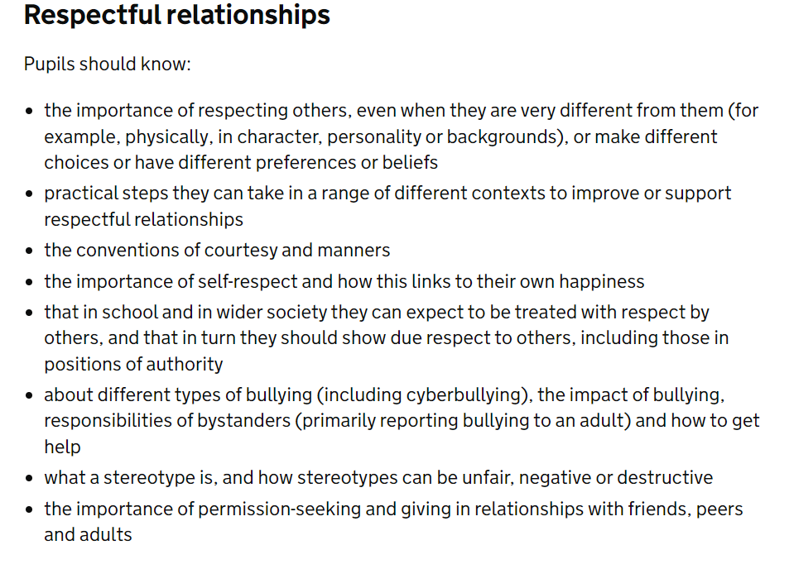

Slide 15
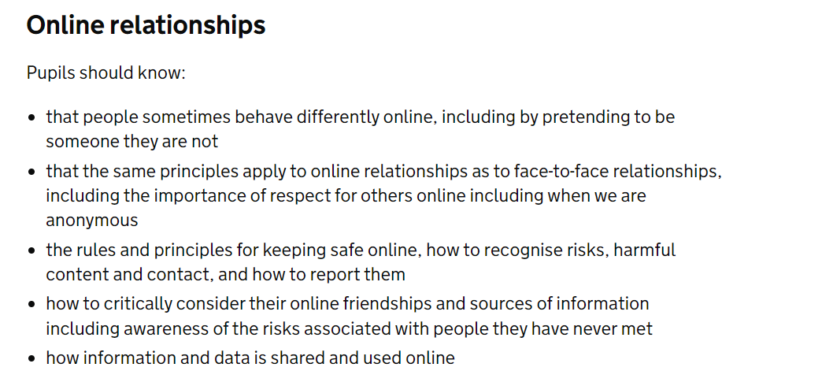

Slide 16
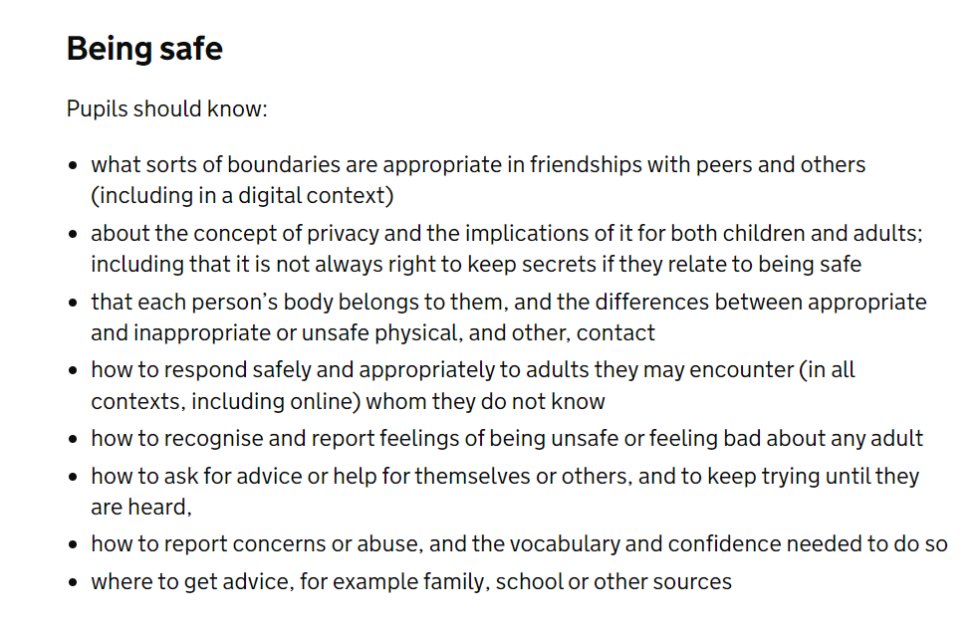

Slide 17
EACT: Policy Position Statement for the teaching of Relationship Education
The importance of parental engagement.
We believe in being open with parents about what we are teaching their children. Through an exchange of knowledge and information with our parents, we feel that our children benefit from being given consistent messages in an academy and at home.
We therefore encourage parents to share their thoughts with us and to review our teaching materials and policies. Most importantly if any parents have specific concerns about the content of the curriculum being taught, please request to meet with the headteacher so that we can allay your concerns, explain what we teach and how.
Slides from today uploaded to website re. DfE documentation
Curriculum vocabulary – overview (amended version)
Log on CPOMs re. curriculum opt out

Slide 18
Department for Education:
The focus in primary school should be on teaching the fundamental building blocks and characteristics of positive relationships, with particular reference to friendships, family relationships, and relationships with other children and with adults.
This starts with pupils being taught about what a relationship is, what friendship is, what family means and who the people are who can support them. From the beginning of primary school, building on early education, pupils should be taught how to take turns, how to treat each other with kindness, consideration and respect, the importance of honesty and truthfulness, permission seeking and giving, and the concept of personal privacy.
Establishing personal space and boundaries, showing respect and understanding the differences between appropriate and inappropriate or unsafe physical, and other, contact – these are the forerunners of teaching about consent, which takes place at secondary.
Respect for others should be taught in an age-appropriate way, in terms of understanding one’s own and others’ boundaries in play, in negotiations about space, toys, books, resources and so on.

Slide 19
From the beginning, teachers should talk explicitly about the features of healthy friendships, family relationships and other relationships which young children are likely to encounter. Drawing attention to these in a range of contexts should enable pupils to form a strong early understanding of the features of relationships that are likely to lead to happiness and security. This will also help them to recognise any less positive relationships when they encounter them.
The principles of positive relationships also apply online especially as, by the end of primary school, many children will already be using the internet. When teaching relationships content, teachers should address online safety and appropriate behaviour in a way that is relevant to pupils’ lives. Teachers should include content on how information and data is shared and used in all contexts, including online; for example, sharing pictures, understanding that many websites are businesses and how sites may use information provided by users in ways they might not expect.

Slide 20
Teaching about families requires sensitive and well-judged teaching based on knowledge of pupils and their circumstances. Families of many forms provide a nurturing environment for children. (Families can include for example, single parent families, families headed by grandparents, LGBT parents, adoptive parents, foster parents and carers amongst other structures.) Care needs to be taken to ensure that there is no stigmatisation of children based on their home circumstances and needs, to reflect sensitively that some children may have a different structure of support around them; for example, looked after children or young carers.
A growing ability to form strong and positive relationships with others depends on the deliberate cultivation of character traits and positive personal attributes, (sometimes referred to as ‘virtues’) in the individual. In a school wide context which encourages the development and practice of resilience and other attributes, this includes character traits such as helping pupils to believe they can achieve, persevere with tasks, work towards long-term rewards and continue despite setbacks. Alongside understanding the importance of self-respect and self-worth, pupils should develop personal attributes including honesty, integrity, courage, humility, kindness, generosity, trustworthiness and a sense of justice. This can be achieved in a variety of ways including by providing planned opportunities for young people to undertake social action, active citizenship ‎and voluntary service to others locally or more widely.

Slide 21
Relationships Education also creates an opportunity to enable pupils to be taught about positive emotional and mental wellbeing, including how friendships can support mental wellbeing.
Through Relationships Education (and RSE), schools should teach pupils the knowledge they need to recognise and to report abuse, including emotional, physical and sexual abuse. In primary schools, this can be delivered by focusing on boundaries and privacy, ensuring young people understand that they have rights over their own bodies. This should also include understanding boundaries in friendships with peers and also in families and with others, in all contexts, including online.
Pupils should know how to report concerns and seek advice when they suspect or know that something is wrong. At all stages it will be important to balance teaching children about making sensible decisions to stay safe (including online) whilst being clear it is never the fault of a child who is abused and why victim blaming is always wrong. These subjects complement Health Education and as part of a comprehensive programme and whole school approach, this knowledge can support safeguarding of children.

